Slide 1
Customer Life Time Value Segmentation & Prediction
Alireza Alizadegan

Slide 2


Why customer life time value?
Organizations rely on less than 20% of customers to generate 80% of revenue
5 times more costly to acquire new customers than to maintain existing ones
Identify and keep valuable customers

Slide 3


Business Requirements
SALES STRATEGY
MARKETING STRATEGY
Predict and target high-value customers based on future potential
Develop segmented marketing strategy based on customer past behavior

Slide 4

Agenda
E-commerce Data
Customer Segmentation
K-means Clustering
Marketing Strategies
Life Time Value Prediction
Plan of Action

Slide 5

E-commerce Data & Preprocessing
Data Cleaning
Timestamp format
Date conversion
Feature labels
Missing values
Unnecessary columns
Payment
*Order id
Value
Sequential
Type
Installment
Product
*Product id
Category
Name length
Description length
Photo quantity
Weight
Length
Height width
Order
*Order id
*Customer id
Purchas timestamp
Order status
Invoiced
Shipped
Delivered
Unavailable
Approval timestamp
Delivered courier
Delivered customer
Estimated delivery
Review
Review id
*Order id
Score
Comment title
Comment message
Creation date
Answer timestamp
Item
*Order id
Item id
*Product id
*Seller id
Price
Freight
Seller
*Seller id
Zip code
City
State
Feature Selection & Engineering
Order | Date | Customer | Payment
Customer
*Customer id
Unique id
Zip code
City
State
Geolocation
Zip code
Latitude
Longitude
City
State
Customer | Recency | Frequency | Monetary

Slide 6
Customer segmentation

Slide 7
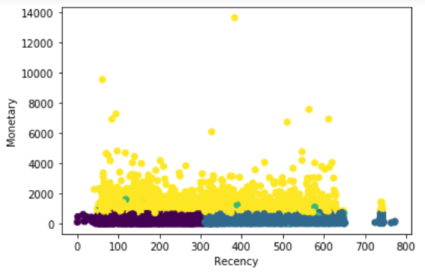
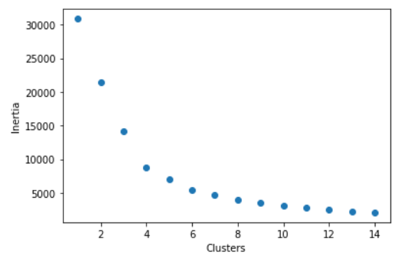
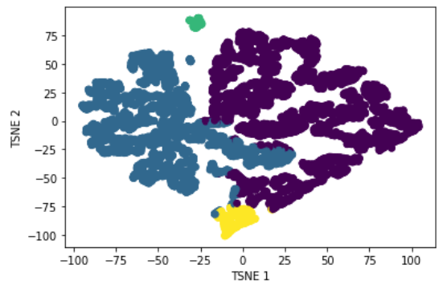
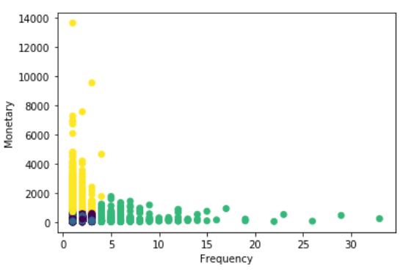
K-means Clustering
MARKETING
REQUIREMENTS
Notes:
Interpretation of this segmentation is that if we were to put customers into a group of four, this particular grouping is such that customers in each group are closest in terms of purchase behavior

Slide 8
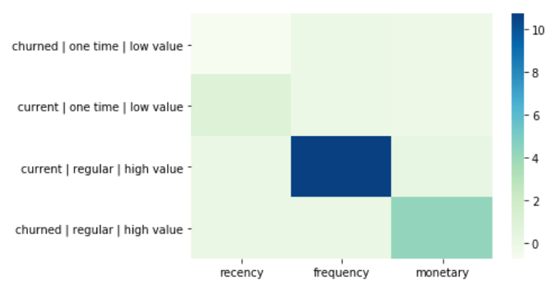
Marketing Strategies
MARKETING STRATEGY
No attempt to require
Welcome offer
Loyalty rewards
Aggressive incentives
SEGMENT BEHAVIOR
Lost
New customers
Champions
Can’t lose

Slide 9
LIFE TIME VALUE Prediction

Slide 10
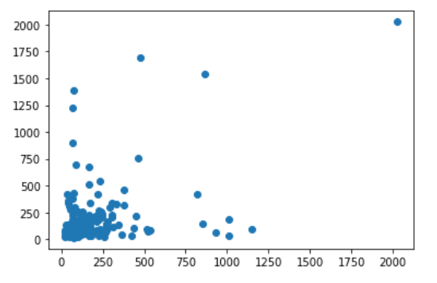
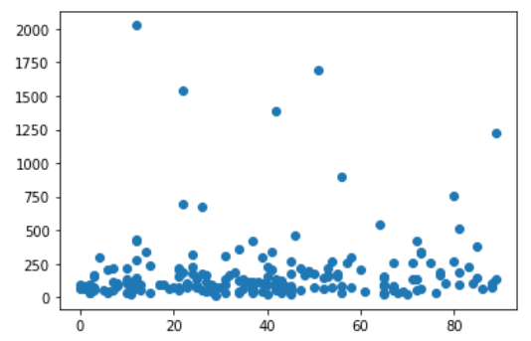
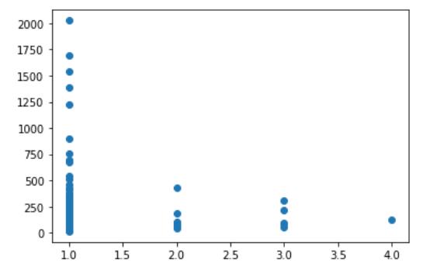
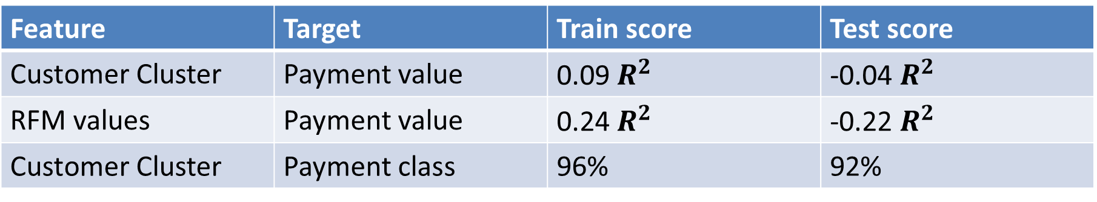
Regression Results
3 months (feature)
6 months (target)
Feature | Target | Train score | Test score
Customer Cluster | Payment value | 0.09 $R^{2}$ | -0.04 $R^{2}$
RFM values | Payment value | 0.24 $R^{2}$ | -0.22 $R^{2}$
Customer Cluster | Payment class | 96% | 92%
Monetary
Recency
Frequency

Slide 11
Plan of Action
Increase accuracy of life time value predictions
Longer time windows
Additional features
Predict churn rate
Identify products associated with negative customer sentiment

Slide 12

Thank You!

Slide 13
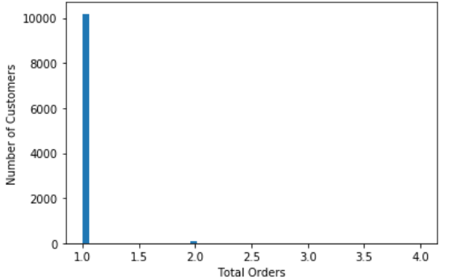
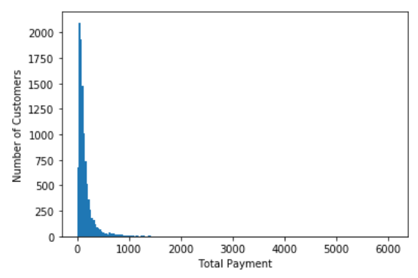
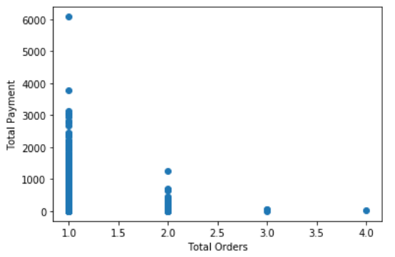
Exploratory Data Analytics

